Slide 1
ENGINEERING CHEMISTRY - II
22CH203
Unit 5 – Lesson Plan 2

Slide 2
Radioactive decay
Radioactive decay
Alpha
Beta
Gamma

Slide 3
Alpha particle emission
An alpha particle is composed of two protons and two neutrons and is the same as a helium nucleus. It has a 2+ charge.
When a radioactive atom emits an alpha particle, the original atom’s atomic number decreases by two (because of the loss of two protons), and its mass number decreases by four (because of the loss of four nuclear particles).

Slide 4

Alpha particle emission

Slide 5
beta particle emission
A beta particle is an electron ejected from the nucleus (not from the shells of electrons about the nucleus) and has a -1 charge.
We can also represent a beta particle as ₋₁e⁰.
The net effect of beta particle emission on a nucleus is that a neutron is converted to a proton.
The overall mass number stays the same, but because the number of protons increases by one, the atomic number goes up by one.

Slide 6
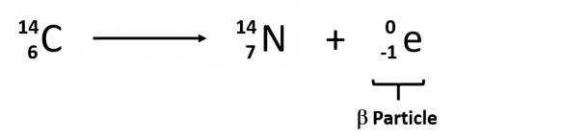
beta particle emission

Slide 7
Gamma Radiation
The third major type of radioactive emission is not a particle but rather a very energetic form of electromagnetic radiation called gamma rays, symbolized by the Greek letter γ.
Gamma rays are examples of ionizing radiation.
Some radioactive materials, emit gamma radiation during their decay.

Slide 8
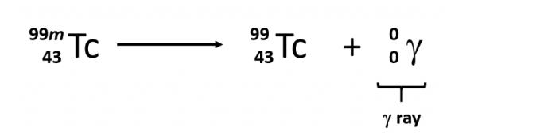
Gamma Radiation
For example, in the decay of radioactive technetium99, a gamma ray is emitted.
Note that in radioactive decay where the emission of gamma radiation occurs, that the identity of the parent material does not change, as no particles are physically emitted.

Slide 9
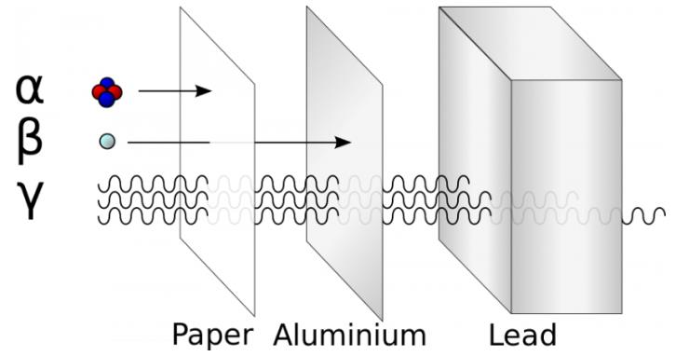
Penetrating power
Typical alpha particles (a) are stopped by a sheet of paper, while beta particles (ß) are stopped by an aluminum plate. Gamma radiation (γ) is damped when it penetrates lead.

Slide 10
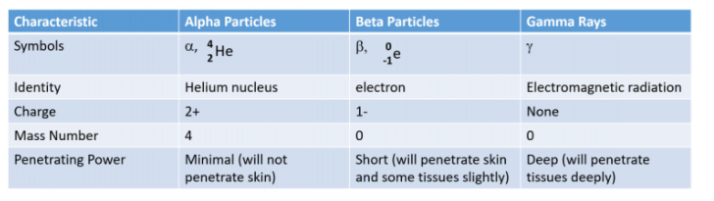
Summary

Slide 11
Positron Emission
The positron has the mass of an electron, but a positive charge.
Positron emission is observed for nuclides in which the n:p ratio is low.
These nuclides lie below the band of stability.
Positron decay is the conversion of a proton into a neutron with the emission of a positron. The n:p ratio increases, and the daughter nuclide lies closer to the band of stability than did the parent nuclide.

Slide 12

Positron Emission
The overall mass of the nuclide doesn’t change, but the atomic number is decreased by one.

Slide 13

Electron capture
Electron capture occurs when one of the inner electrons in an atom is captured by the atom’s nucleus.
An inner shell electron combines with a proton and is converted into a neutron.
The loss of an inner shell electron leaves a vacancy that will be filled by one of the outer electrons. As the outer electron drops into the vacancy, it will emit energy. In most cases, the energy emitted will be in the form of an X-ray

Slide 14
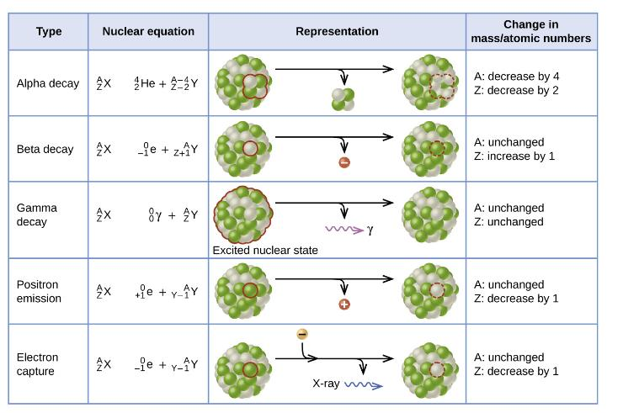

Slide 15
Radioactive Half Life Period:
Each radioactive nuclide has a constant half-life (t_{1/2}), the time required for half of the atoms in a sample to decay.
The intensity of radiation that it produces is directly proportional to the rate of decay of the substance and the amount of the substance.

Slide 16
Radioactive Half Life Period:
For cobalt-60, which has a half-life of 5.27 years, it takes 5.27 years (one half-life) to become 50%
25% remains after 10.54 years (two half-lives)
12.5% remains after 15.81 years (three half-lives), and so on.
Note that every half-life is the same length of time.

Slide 17
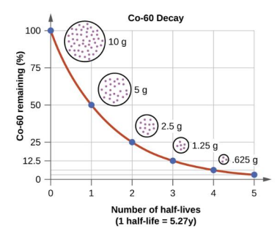
Radioactive Half Life Period:

Slide 18

Radioactive Half Life Period:

Slide 19
EFFECTS OF RADIATION EXPOSURE:
Ionizing radiation may cause severe damage by breaking bonds or removing electrons in biological molecules, disrupting their structure and function.
Radiation can harm either the whole body (somatic damage) or eggs and sperm (genetic damage).
Its effects are more pronounced in cells that reproduce rapidly, such as the stomach lining, hair follicles, bone marrow, and embryos.
This is why patients undergoing radiation therapy often feel nauseous or sick to their stomach, lose hair, have bone aches, and so on, and why particular care must be taken when undergoing radiation therapy during pregnancy.

Slide 20
Applications
The wear of surfaces, e.g. of piston rings and of gears in engines, and its prevention by means of suitable lubricants have been studied.
To study age-hardening, annealing, quenching, and cold rolling in metals.
The phenomenon of self-diffusion in a metal i.e. the movement of the atoms of a metal within the crystal lattice is determined with the help of radioactive traces.
Radioactive tracers also provide a convenient means for detecting leaks, especially in buried pipes carrying water or petroleum

Slide 21
Applications - medicine
Circulation of blood.
Goitre (Thyroiditis)
Brain Tumour Location
Treatment of blood abnormalities

